Slide 1
Volvo of the Triad
Winston-Salem
Search Engine Marketing
Campaign Performance Summary
July/August 2013

Slide 2
Campaign Overview
Start date: 7/24/2013
End date: 8/18/2013
Budget: $2,000.00
Spend: $2,041.68
Results:
  Impressions: 33,584
  Site visits: 948
  Cost per visit: $2.15
  Avg. click-through rate: 2.82%
  Click-to-call rate: 20.99%
  Avg. page position: 2.9

Slide 3
Cost per visit (CPV) averaged $2.15
Volvo of the Triad Winston-Salem - PAID SEARCH CAMPAIGN
COST PER VISIT OVER TIME
Average visits/day: 36 Average CPV: $2.15

Slide 4
Keyword optimization and relevant search ads contribute to great click through %
Volvo of the Triad Winston-Salem - PAID SEARCH CAMPAIGN
CLICK THROUGH RATE OVER TIME
  Average click through rate: 2.82%

Slide 5






Delivering the right ads at the right time to achieve maximum results
Volvo of the Triad Winston-Salem - PAID SEARCH CAMPAIGN
EXAMPLES OF CURRENT PAID SEARCH ADS

Slide 6


62% of visitors viewed pre-owned vehicles
Volvo of the Triad Winston-Salem - PAID SEARCH CAMPAIGN
INDIVIDUAL PAGE VIEWS BY %
11
1

Slide 7
Campaign generated 483 page views on pre-owned inventory pages
Volvo of the Triad Winston-Salem - PAID SEARCH CAMPAIGN
TOTAL # OF INDIVIDUAL PAGE VIEWS:

Slide 8
ProExel’s campaign generated 352 conversions over 25 days
Volvo of the Triad Winston-Salem - PAID SEARCH CAMPAIGN
CONVERSION BREAKDOWN

Slide 9



Dynamic keyword optimization =
More conversions for less money
Volvo of the Triad Winston-Salem - PAID SEARCH CAMPAIGN
TOP 5 KEYWORDS FOR EACH PUBLISHER
volvo greensboro
volvo of the triad
the triad volvo
volvo of the triad winston salem nc
new volvo winston salem nc
volvo of the triad
volvo dealership winston salem nc
the triad volvo
volvo dealership
volvo greensboro

Slide 10
Average daily spend rate over 100% identifies additional opportunity
Volvo of the Triad Winston-Salem - PAID SEARCH CAMPAIGN
% OF BUDGET OVER TIME
Average % of daily budget: 122.5%

Slide 11
Campaign Observations
Volvo of the Triad Winston-Salem - PAID SEARCH CAMPAIGN
All campaign metrics continue to perform at above average levels
Conversion-based optimization benefits from and contributes to mature, stable campaign
Average cost per visit (CPV) has remained stable at $2.13 YTD
Average Click-through ratio (CTR) has remained stable at 2.71% YTD
Continue to monitor average daily spend rate and increase budget if warranted

Slide 12
Volvo of the Triad
Charlotte
Search Engine Marketing
Campaign Performance Summary
July/August 2013

Slide 13
Campaign Overview
Start date: 7/24/2013
End date: 8/16/2013
Budget: $1,000.00
Spend: $1,010.74
Results:
  Impressions: 20,167
  Site visits: 829
  Cost per visit: $1.22
  Avg. click-through rate: 1.04%
  Click-to-call rate: 3.98%
  Avg. page position: 2.1

Slide 14
Cost per visit (CPV) averaged $1.22
Volvo of the Triad Charlotte - PAID SEARCH CAMPAIGN
COST PER VISIT OVER TIME
Average visits/day: 31 Average CPV: $1.22

Slide 15
Keyword optimization and relevant search ads contribute to good click through %
Volvo of the Triad Charlotte - PAID SEARCH CAMPAIGN
CLICK THROUGH RATE OVER TIME
  Average click through rate: 1.04%

Slide 16






Delivering the right ads at the right time to achieve maximum results
Volvo of the Triad Charlotte - PAID SEARCH CAMPAIGN
EXAMPLES OF CURRENT PAID SEARCH ADS

Slide 17
72% of visitors viewed pre-owned vehicles
Volvo of the Triad Charlotte - PAID SEARCH CAMPAIGN
INDIVIDUAL PAGE VIEWS BY %
11
1

Slide 18
Campaign generated 110 page views on pre-owned inventory pages
Volvo of the Triad Charlotte- PAID SEARCH CAMPAIGN
TOTAL # OF INDIVIDUAL PAGE VIEWS:

Slide 19
ProExel’s campaign generated 57 conversions over 24 days
Volvo of the Triad Charlotte - PAID SEARCH CAMPAIGN
CONVERSION BREAKDOWN

Slide 20
Dynamic keyword optimization =
More conversions for less money
Volvo of the Triad Charlotte - PAID SEARCH CAMPAIGN
TOP 5 KEYWORDS FOR EACH PUBLISHER
volvo of the triad
volvo charlotte
volvo dealership charlotte
volvo dealers charlotte
used volvo
the triad volvo dealership charlotte
certified volvo charlotte
volvo of the triad
the triad volvo
volvo dealership

Slide 21
Average daily spend rate over 100% identifies additional opportunity
Volvo of the Triad Charlotte - PAID SEARCH CAMPAIGN
% OF BUDGET OVER TIME
Average % of daily budget: 126.34%

Slide 22
Campaign Observations
Volvo of the Triad Charlotte- PAID SEARCH CAMPAIGN
All campaign metrics continue to perform at above average levels
Conversion-based optimization benefits from and contributes to mature, stable campaign
Average cost per visit (CPV) has improved substantially from $2.21 YTD to $1.22
Average click through ratio (CTR) has improved marginally from 1% YTD to 1.04%
Continue to monitor average daily spend rate and increase budget if warranted

Slide 23
Volvo of the Triad
Raleigh
Search Engine Marketing
Campaign Performance Summary
July/August 2013

Slide 24
Campaign Overview
Start date: 7/24/2013
End date: 8/17/2013
Budget: $1,000.00
Spend: $1,062.74
Results:
  Impressions: 26,664
  Site visits: 615
  Cost per visit: $1.71
  Avg. click-through rate: 2.31%
  Click-to-call rate: 5.69%
  Avg. page position: 1.9

Slide 25
Cost per visit (CPV) averaged $1.71
Volvo of the Triad Raleigh- PAID SEARCH CAMPAIGN
COST PER VISIT OVER TIME
Average visits/day: 25 Average CPV: $1.71

Slide 26
Keyword optimization and relevant search ads contribute to great click through %
Volvo of the Triad Raleigh - PAID SEARCH CAMPAIGN
CLICK THROUGH RATE OVER TIME
  Average click through rate: 2.31%

Slide 27






Delivering the right ads at the right time to achieve maximum results
Volvo of the Triad Raleigh - PAID SEARCH CAMPAIGN
EXAMPLES OF CURRENT PAID SEARCH ADS

Slide 28
65% of visitors viewed pre-owned vehicles
Volvo of the Triad Raleigh - PAID SEARCH CAMPAIGN
INDIVIDUAL PAGE VIEWS BY %
11
1

Slide 29
Campaign generated 144 page views on pre-owned inventory pages
Volvo of the Triad Raleigh- PAID SEARCH CAMPAIGN
TOTAL # OF INDIVIDUAL PAGE VIEWS:

Slide 30
ProExel’s campaign generated 80 conversions over 24 days
Volvo of the Triad Raleigh - PAID SEARCH CAMPAIGN
CONVERSION BREAKDOWN

Slide 31
Dynamic keyword optimization =
More conversions for less money
Volvo of the Triad Raleigh - PAID SEARCH CAMPAIGN
TOP 5 KEYWORDS FOR EACH PUBLISHER
volvo raleigh
volvo dealer raleigh
volvo of the triad
c30 raleigh
volvo durham
volvo raleigh
volvo of the triad
volvo dealers
volvo dealership
volvo cars

Slide 32
Average daily spend rate over 100% identifies additional opportunity
Volvo of the Triad Raleigh - PAID SEARCH CAMPAIGN
% OF BUDGET OVER TIME
Average % of daily budget: 127.53%

Slide 33
Campaign Observations
Volvo of the Triad Raleigh- PAID SEARCH CAMPAIGN
All campaign metrics continue to perform at above average levels
Conversion-based optimization benefits from and contributes to mature, stable campaign
Average cost per visit (CPV) has remained stable at $1.75 YTD
Average Click-through ratio (CTR) has remained stable at 1.28% YTD
Continue to monitor average daily spend rate and increase budget if warranted

Slide 34
Volvo of the Triad
Display Advertisement
Campaign Performance Summary
July/August 2013

Slide 35
Campaign Overview
Start date: 7/10/2013
End date: 8/4/2013
Budget: $1,500.00
Spend: $1,651.63
Results:
  Total Impressions: 657,141
  Targeted Impressions: 648,806
  Remarketed Impressions: 8,335
  Site visits: 366
  CPM: $2.28
  CPV: $4.09

Slide 36
Cost per one thousand impressions (CPM) only $2.28 on average
Volvo of the Triad– DISPLAY CAMPAIGN
CPM OVER TIME
Average CPM: $2.28

Slide 37
Generating 26,286 impressions per day helps build the VOTT brand
Volvo of the Triad– DISPLAY CAMPAIGN
IMPRESSIONS OVER TIME
Total Impressions: 657,141

Slide 38
Display ads put 14 potential customers on your website each day
Volvo of the Triad– DISPLAY CAMPAIGN
CAMPAIGN SPEND VS SITE TRAFFIC
Average visits/day: 14

Slide 39
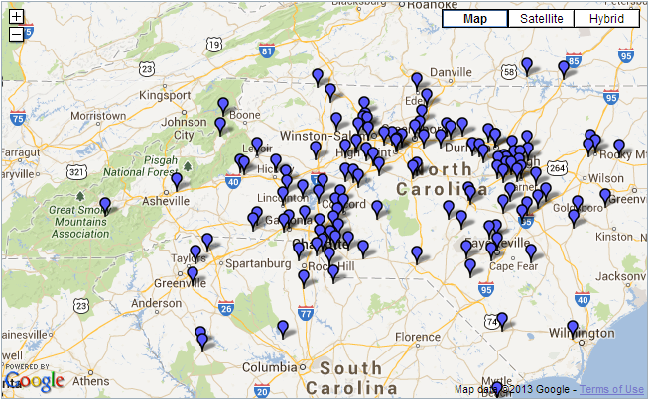
Views and visits from throughout your market area
Volvo of the Triad – DISPLAY CAMPAIGN
MAP OF WHERE YOUR AD WAS LAST SEEN
Notes:
We have the ability to track the last 1,000 visits.

Slide 40
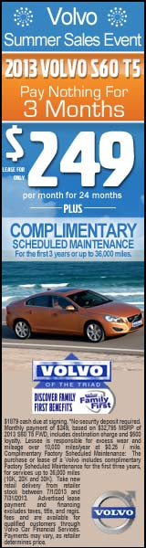

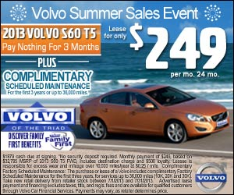
Great Creative + Strategic Targeting = Impressive Results
Volvo of the Triad – DISPLAY CAMPAIGN
EXAMPLES OF CURRENT DISPLAY ADVERTISEMENTS

Slide 41
Campaign Observations
Volvo of the Triad– DISPLAY CAMPAIGN
Ads displayed as consumers surf the most popular national news, entertainment and lifestyle sites
Keeping display creative new and fresh continues to optimize your campaign
CPM (cost per one thousand impressions) averaged only $2.28 during this campaign
The campaign generated 26,286 impressions per day on average throughout your market area
Consider pure retargeting campaign to target in-market shoppers with high value impressions

Slide 42
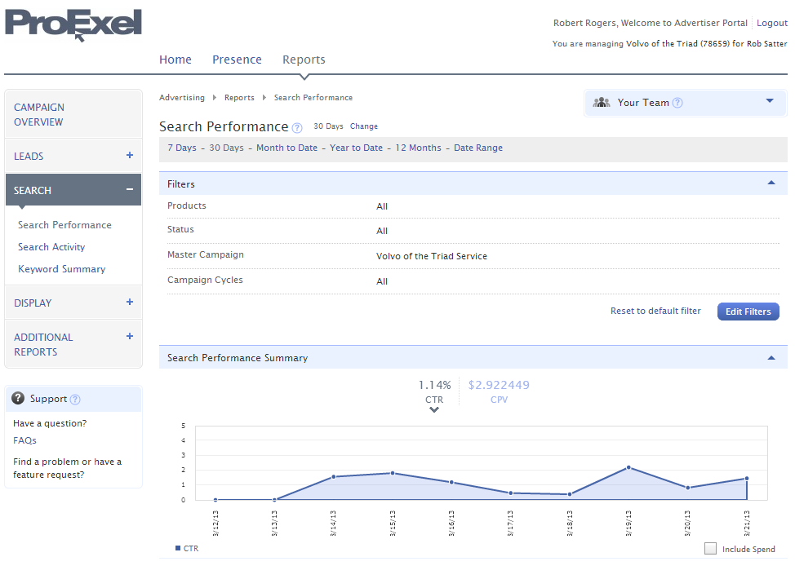

Slide 43
